Slide 1
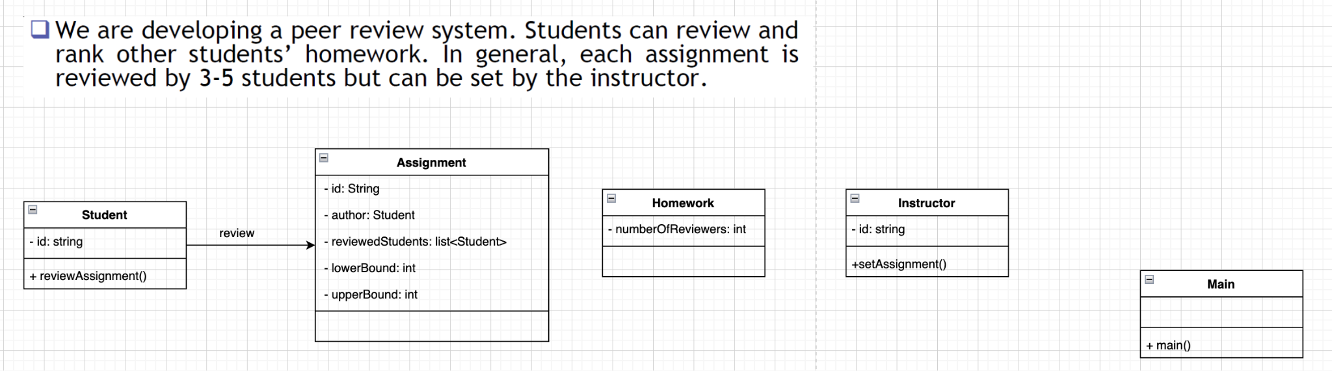

Slide 2
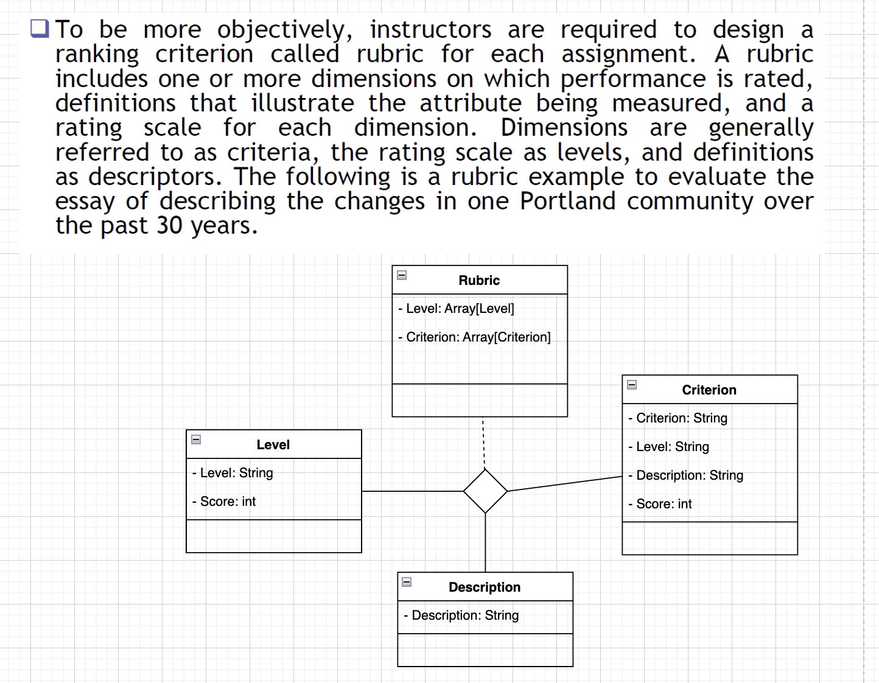
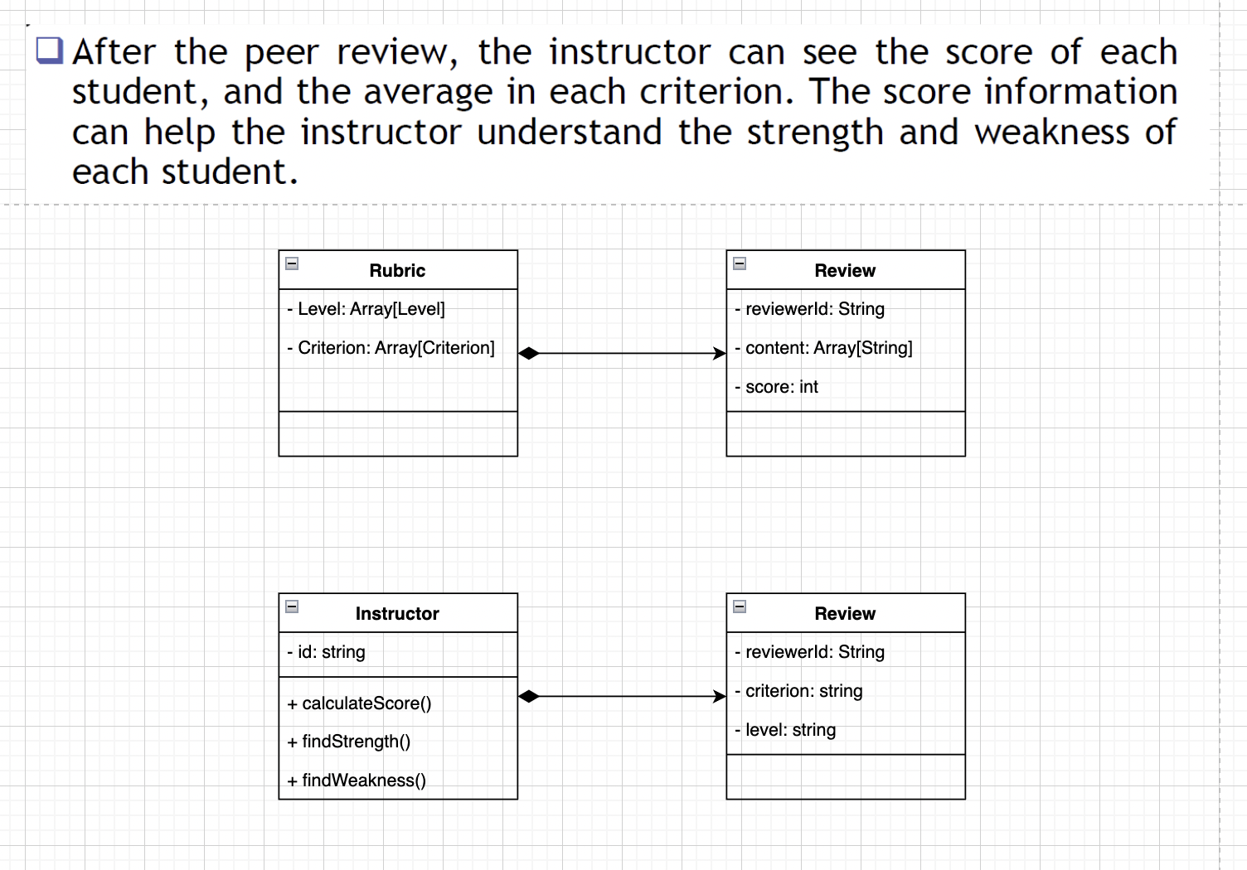

Slide 3
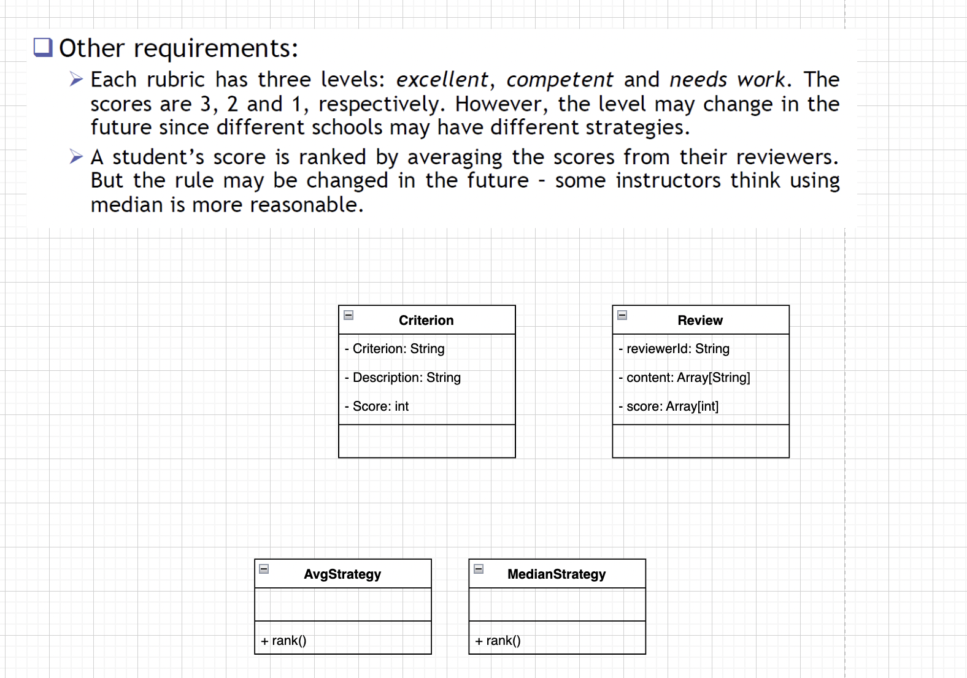

Slide 4
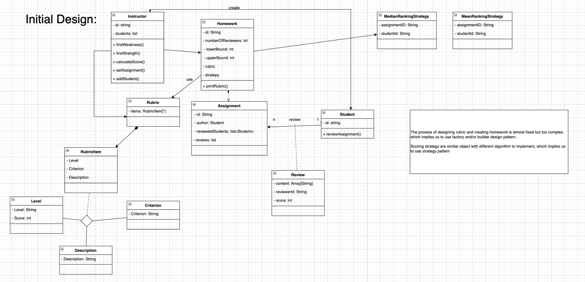

Slide 5
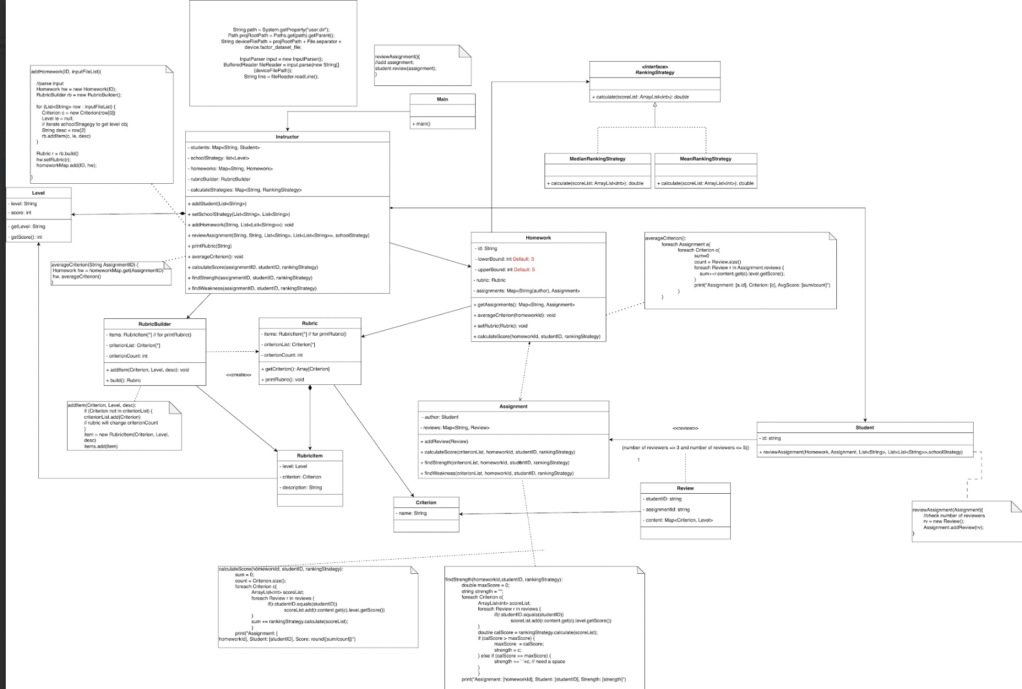
Refactor
(overview)
Sorry Professor and TAs, because our diagram is too big, when we export it, it will be not tha clear, so we decompose it to some parts to show them more clearly, with this overview in advance.

Slide 6
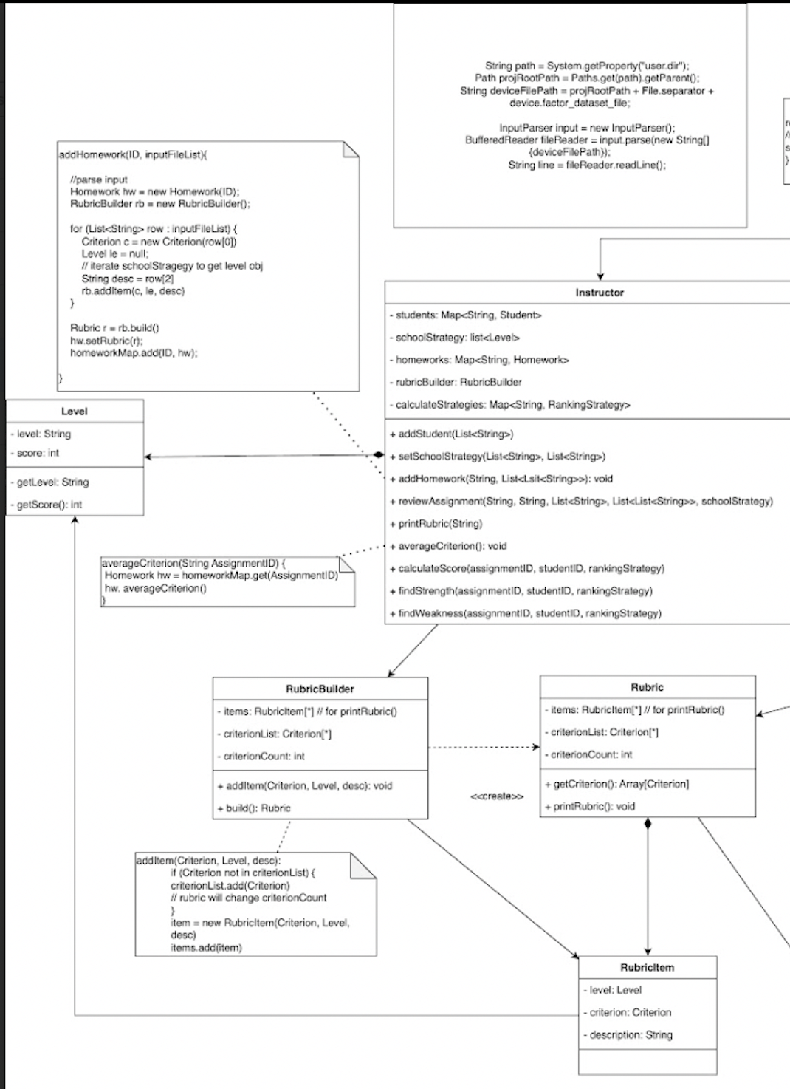
Upper left part

Slide 7
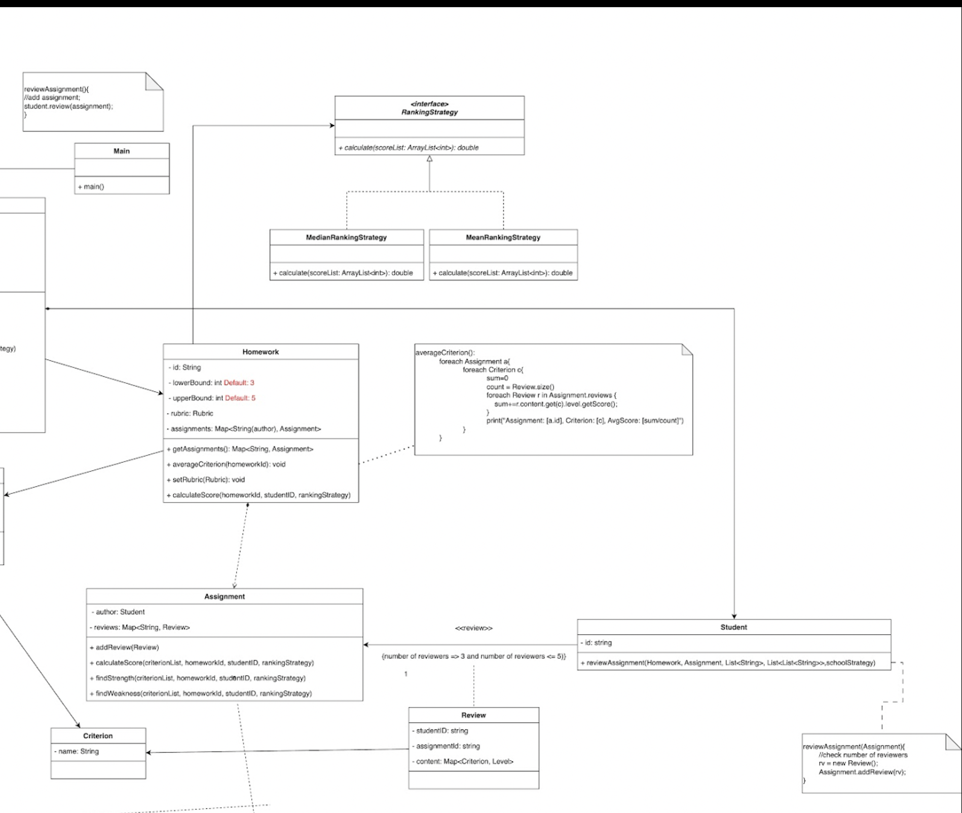
Upper right part

Slide 8
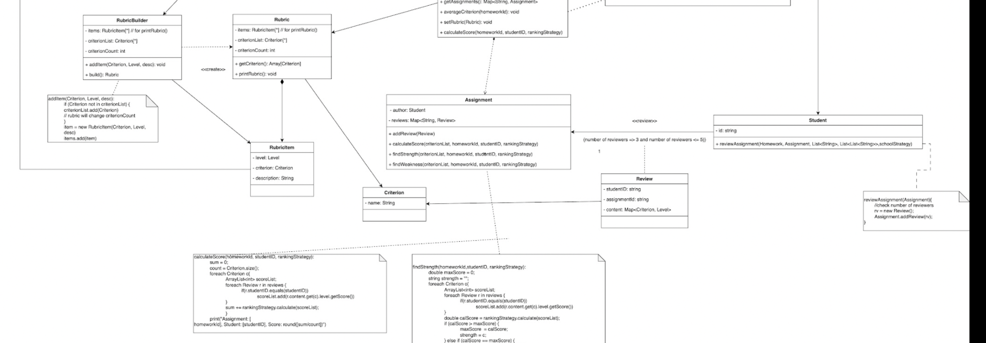
Lower part

